Slide 1

Network Engineering & Design Project
Presentation by
Group A

Slide 2

ANALYSING AND LIST
THE REQUIRMENTS
Description of the Requested Network
The primary goal of the project is to establish a comprehensive network infrastructure that meets the evolving needs of Souq Al-Manama Business School's educational environment. This includes providing constant connectivity, facilitating access to digital resources, and supporting collaborative learning and research activities.
Technical Goals
Enhanced Network Security
Optimized Network Performance
Scalable Network Architecture
User-Friendly Design and High Availability
Business requirements
Improve Academic Productivity
Enhance Souq Al-Manama Business School's Competitiveness
Increase Student Enrollment and Retention:

Slide 3

Requirement | Met (Yes/No) | Fulfilled by
Implement Company Structure | Yes | Cisco Packet Tracer Simulation
Multiple Switches and VLANs | Yes | Utilization of Switches and VLANs
Routing Between VLANs/Branches | Yes | Router-on-Stick Architecture and OSPF Routing
Firewall Implementation | Yes | Integration of Host-Based Firewall and Network-Based Firewall
Network Management | Yes | Integration of SNMP, Syslog, TFTP, NTP, AAA
Network Connectivity Verification | Yes | Successful execution of ping, show IP route, and show VLAN brief commands
Design Analysis
This summary table provides an overview of how each project requirement has been addressed in the design. It indicates whether the requirement has been met and specifies which aspect of the design fulfills this requirement. This allows for a clear and good evaluation of the design's alignment with project requirements.

Slide 4

Requirements and Architecture
We will install 20 high-performance student computers and one instructor computer in each lab, all connected to a secure local area network (LAN). Each research room will be equipped with four advanced computers, also connected to the LAN. Our solution guarantees high-speed internet access, with a Wi-Fi network capable of supporting 60+ users simultaneously. We propose a centralized network storage system that offers good space for data sharing and backups. The servers we install will be powerful enough to handle all computational tasks required by the labs and research rooms.

Slide 5

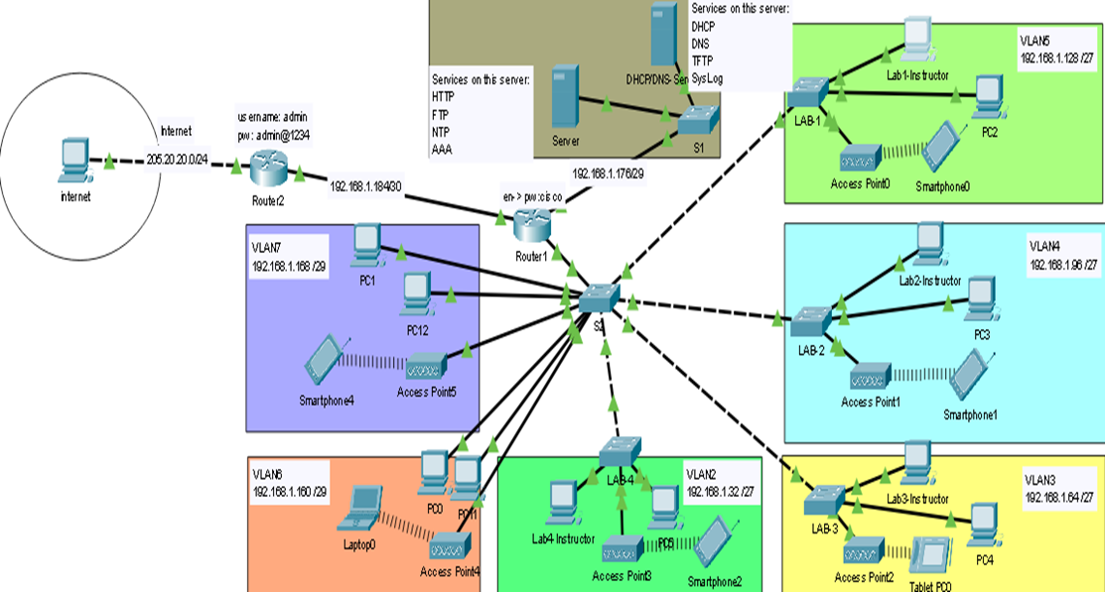
Network Diagram
Devic | Quantity | Vendor
Routers | 2 | Cisco
Switches | 7 | Cisco
Servers | 2 | Cisco
PC’s | 13 | Cisco
AP | 6 | Cisco
Cables | 2 types (Straight-Through & Cross-Over)

Slide 6

Trade-Offs
While the implemented design successfully meets the project requirements, there are some trade-offs to consider. The use of VLANs and routing protocols adds complexity to the network configuration, requiring careful planning and management.

Slide 7

Network Future
Looking forward to the fact that we can keep improving the network. We might upgrade the hardware to handle more traffic, add extra security measures like IPS, and try out new tech like SDN to make things easier to manage. With some upkeep and staying on top of new tech, the network will keep supporting the school's needs and growing along with it.

